Slide 1
Python Lin Reg Model
Jonathan Chen

Slide 2
Connecting to api’s
Searching for location with citybikes
Getting location for restaurants with yelp api
Locations for restaurants with foursquare api

Slide 3
Parsing data to put into dataframes
Using dictionaries key and values
Lists
pd.Dataframe()

Slide 4
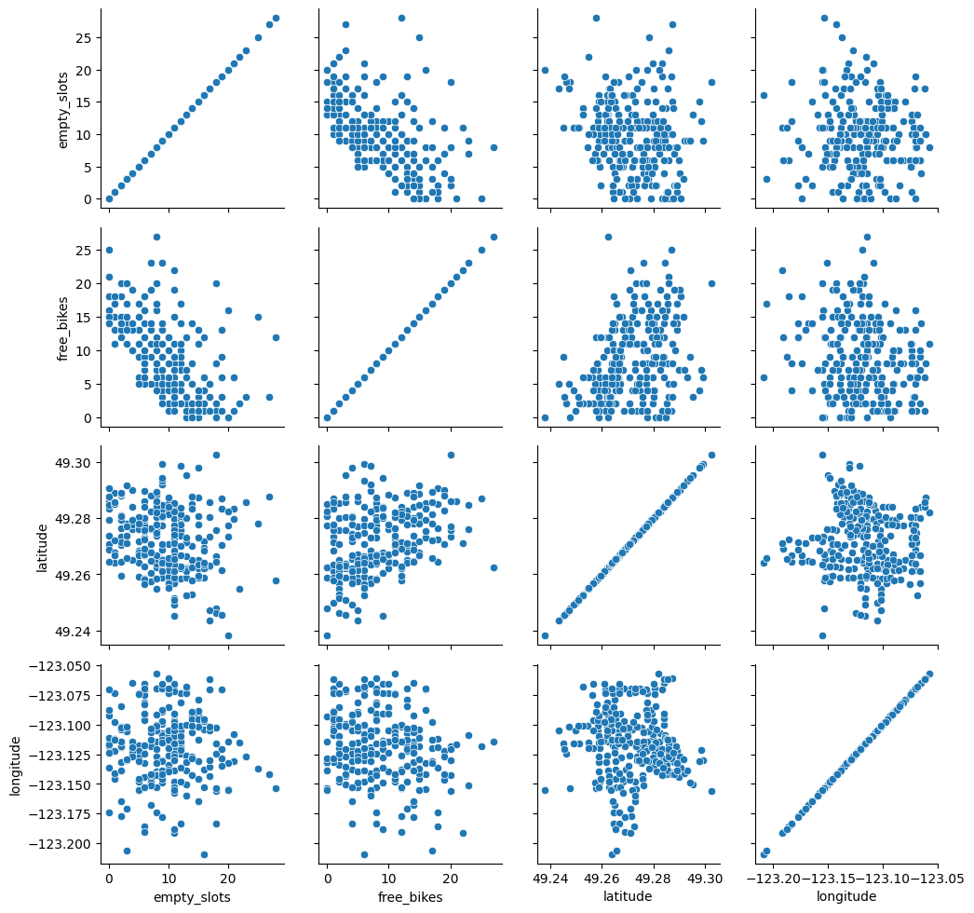
Correlation

Slide 5
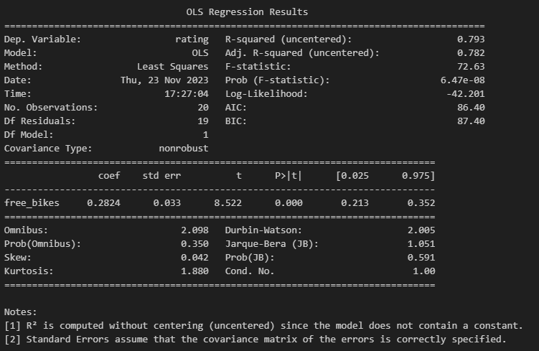
Modeling

